Slide 1

Musings of the Doctor
By Hassan Akbar

Slide 2
Idea
The project that I worked on was a blog website for the fictional character Dr. John Watson of Sherlock Holmes fame.
I thought I could come up with a bunch of different interesting pages for this concept.
The website would be a place to catalogue closed and ongoing cases as well as allow some user interaction and advertisement.

Slide 3
Initial Version
https://ha-work.github.io/CISC3141_FirstProject/index.html
This final project is an updated version of the first project that I made for this class.

Slide 4
Basic Structure

Slide 5
Home page
This is the landing page for the website. At the top of the page is the navbar. The background of this page is a picture of the real-life Scotland Yard which is the police force Sherlock Holmes works with. It has a picture of a magnifying glass to represent detective work.

Slide 6
About Page
This page explains the purpose of the website, the different pages of the website, and the people involved with the website. The page has an ordered list of the main 4 sections of this page. The links on the list take you to that specific section. The first 3 sections are for Dr. Watson, Det. Holmes and Arthur Conan Doyle. Each section gives a brief summary of the person and has a table that lists their address, email, phone number and available times. The last section is the area of operations page which says that Watson and Holmes mostly work in London and accompanied is a map of London.

Slide 7
Crime Stats
This page gives the breakdown of the different types of crime and their monthly averages.

Slide 8
Closed Cases
This page is a record of the current successfully completed cases of Watson and Holmes. Each case has a brief description and a link to where the book can be purchased.

Slide 9
Open Cases
This page is a list of the cases that are currently being investigated. Each case has a brief description of how the case came to them.

Slide 10
Recipes
The idea for this page was to add a lighthearted element to the website and so I chose to have Dr. Watson share recipes with the people visiting his website. The page has a picture of a cup of tea, an unordered list of the ingredients and an ordered list of the steps. It also has a short description of the tea. I got this recipe after looking up a tea recipe.

Slide 11
Login
This page asks for your username and password so that you can sign into your account on the website.
Has a link to a signup page if the user does not have an account.

Slide 12
Clues
This is a page so that people can upload stuff about open cases.

Slide 13
Hunt
A page that lets the user play a simple deduction game

Slide 14
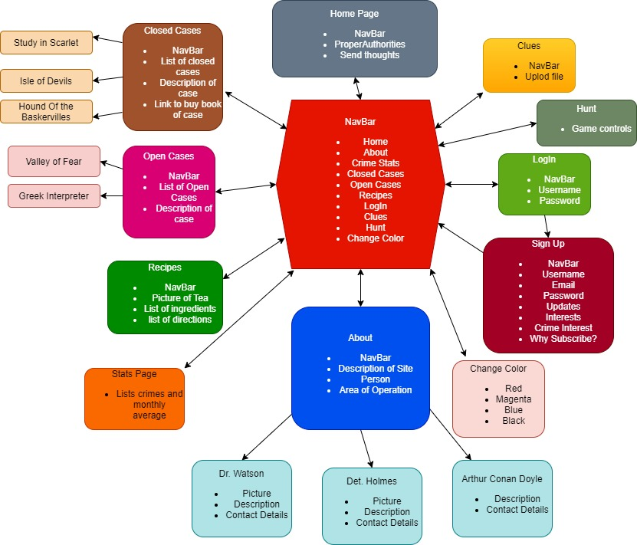

Slide 15
Changes to the Website

Slide 16
Changes to whole site
Changed the backgrounds of pages from plain white to a color gradient to make it look nicer
Added a feature to the navbar that lets you change the color of text on a page
Did this using the color changer code

Slide 17
Home Page
Added a magnifying section so you can examine closer the picture of Scotland Yard

Slide 18
Crime Stats
Created this page so that we can use a real life Police API

Slide 19
Closed Cases
Added a search bar that lets you search for specific cases
Would be very useful when the number of cases gets large

Slide 20
Open Cases
Added a way to add tentative cases to the page
Based on the homework tracker
Created a list of leads that you can add, delete and cross out

Slide 21
Recipes
Add an accordion button to the ingredients

Slide 22
Login
Added a greeting that changes depending on the time
Did this using my answer to the class exercise

Slide 23
Sign Up
Moved this so that it is accessed through the login page

Slide 24
Hunt
Created a game that ties in with the theme of the website

Slide 25
Final thoughts

Slide 26
Struggles
There is a lot of things that goes into building a website. Especially one that allows you to make changes that can be stored. That is the purpose of backend engineering that lets you create objects that store these changes.
W3Schools was an incredibly useful resource for me in making the initial and final versions of this product. They have a lot of code that you can repurpose for your own website.
One limitation that I had is that it was hard to combine some of these concepts.
For example when it comes to the magnification on the home page I wanted the magnifying glass to come from the magnifying glass picture on the page and effect everything on the page but that seems to be very hard to do.
Would be nice for repeating components like the navbar to be stored as an object so it stays updated

Slide 27
Room for improvement
Get the signup and login working
Only let Watson add content to the site
Let users post comments
Make the closed cases and open cases related so you can move the cases between the two pages

